Slide 1

Mobile Application Development, Fall 2021 Components, Props, and Lists

Slide 2
Today’s Agenda
Introduction to Lists!
The FlatList Element
Key Properties
Some Additional FlatList Notes
A Final Challenge

Slide 3
Introduction to Lists!
Lists are a very fundamental part of a lot of apps!
They are so fundamental, that you might not even think of the content of the lists *as* lists!

Slide 4
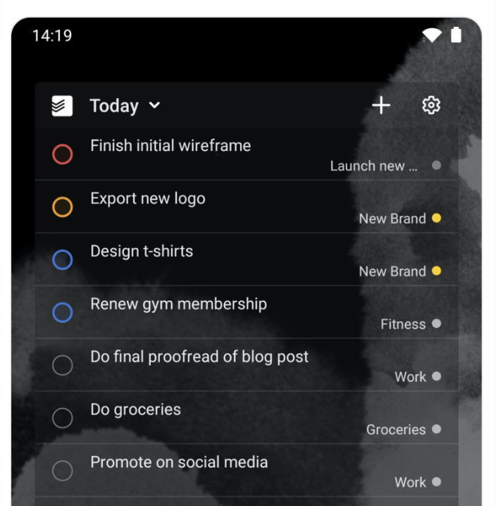
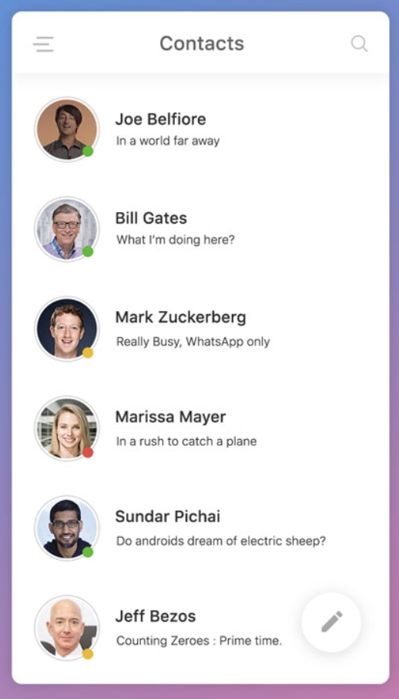
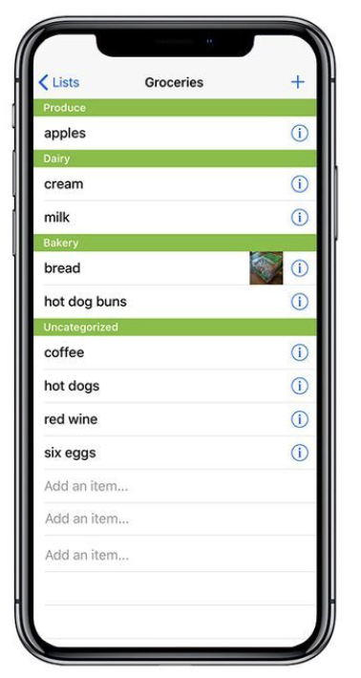
Introduction to Lists!
Sure, there are apps out there that really lean into the notion of lists!
Things like your contact list…
Or a grocery list app…
Or To-Do list apps…

Slide 5
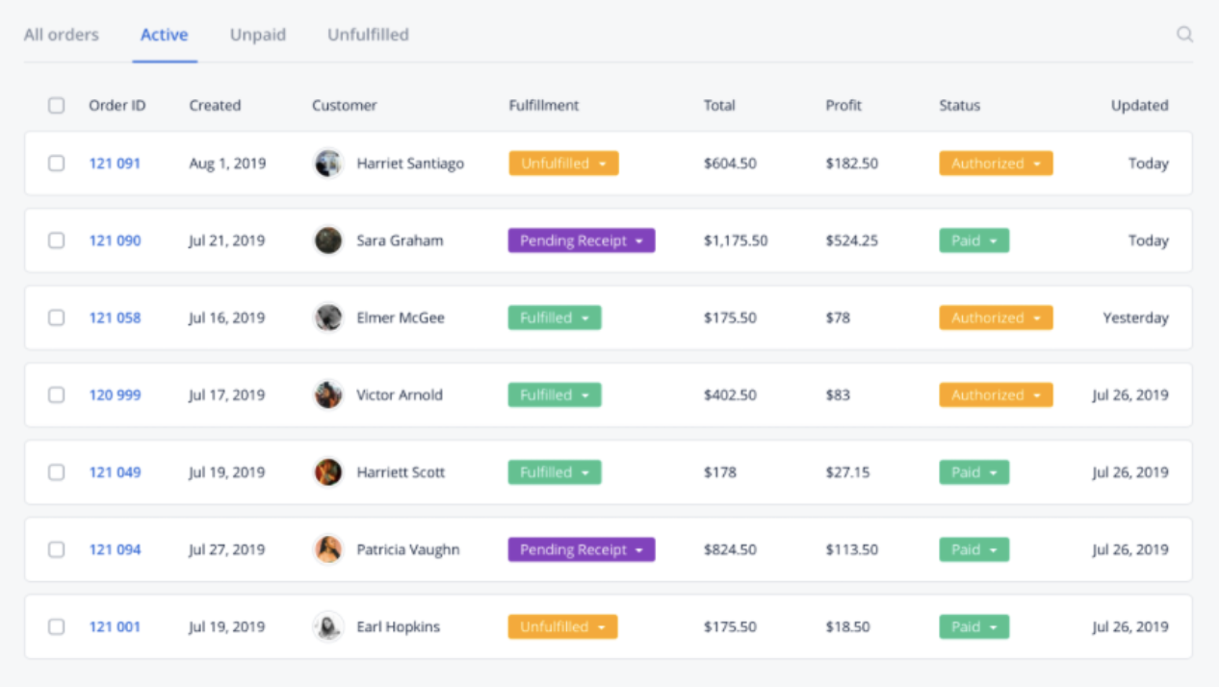
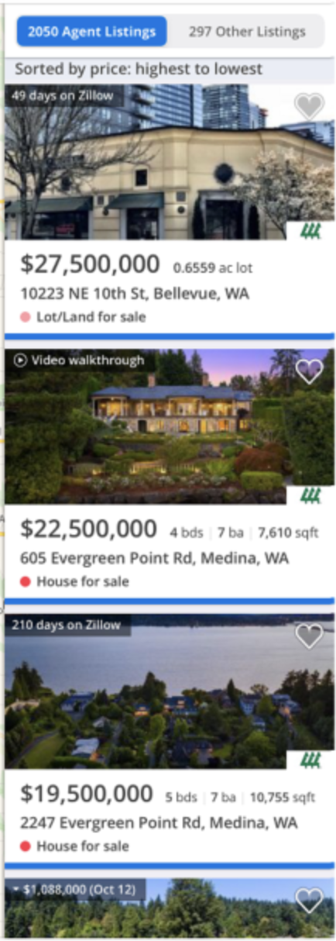

Introduction to Lists!
But through content and styling, lists can become so much more!
It’s a collection of all of your customers!
It’s home listings on Zillow!
It’s “cards” for your favorite music albums!

Slide 6
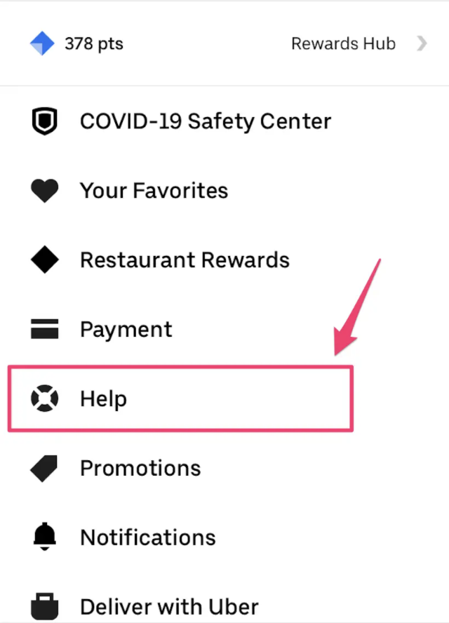
Introduction to Lists!
Lists are also used as a form of navigation, to enable users to access different screens of your app!
Lists are everywhere! Here is a collection of some particularly beautifully designed lists: https://www.mockplus.com/blog/post/list-ui-design

Slide 7
Introduction to Lists!
The lists we are going to learn about today are perhaps not going to be as eye grabbing as those examples!
But we need to learn how to walk before we can run!

Slide 8
Introduction to Lists!
So here’s how we will start: let’s make a new screen in our rn-starter project!
And like, y’know, if you can: actually do this! Follow along at home!
Have it be called ListScreen, and define it in a new file ListScreen.js
Remember the four parts:
1) Importing (for now, let’s import all of React again, as well as Text, StyleSheet, and View)
2) A function that returns a component (for now, just return a text element)
3) the stylesheet (for now, can be an empty stylesheet).
4) exporting
Notes:
Much like last time: I highly recommend that as I go through lecture, you “follow along”, and code alongside with me. There’s no substitute for practice!

Slide 9
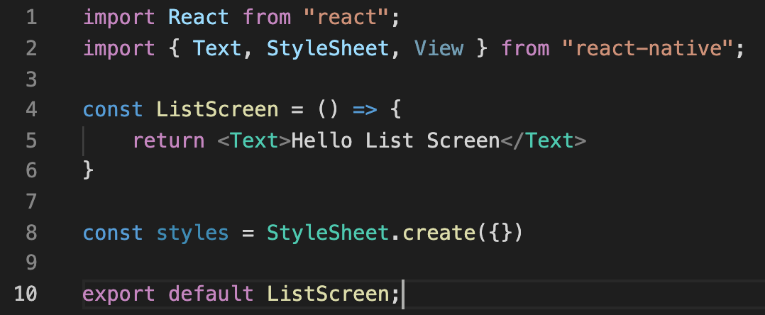



Introduction to Lists!
Probably looks something like this?
Importing the things that we said…
Defining our function that returns our component in JSX form (right now NOT a list)
Our empty stylesheet
Exporting our component!

Slide 10
Introduction to Lists!
But also as we learned last time, that alone won’t be enough to get it come up!
Go to your App.js file and, just like last time, edit it so that we “start” at this new ListFile.js.
I’ll give you all a minute or so to do that.

Slide 11
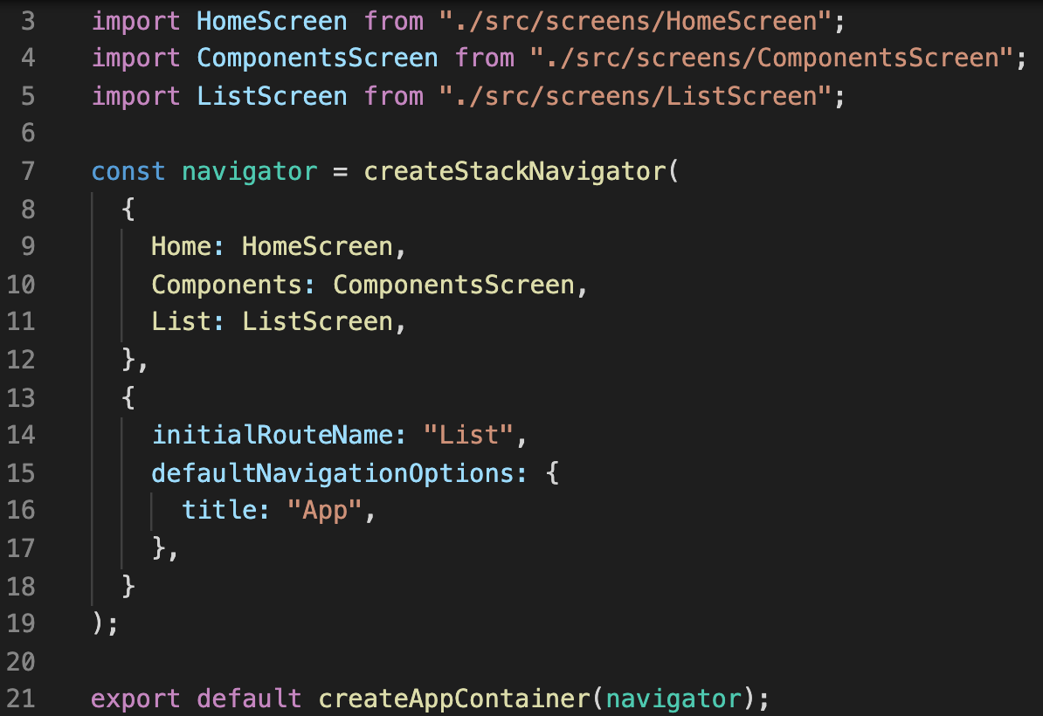



Introduction to Lists!
Looks a little like this, yeah?
We import the ListScreen component that we just exported
We edit our navigator in a couple of places
More on Navigators later!

Slide 12
Introduction to Lists!
OK, so by this point we:
Understand that lists are good and common and fundamental!
Have a new blank screen that we can easily add stuff to.
Let’s get our hands dirty with lists!

Slide 13
Today’s Agenda
Introduction to Lists!
The FlatList Element
Key Properties
Some Additional FlatList Notes
A Final Challenge

Slide 14
The FlatList Element
When you think of lists, you probably think of arrays!
As we likely are very well aware of by this point, arrays are nice ways to collect data together.

Slide 15
The FlatList Element
You can store basically any time of data you want in them!
Like strings, or ints
“Hello!”
27
“We”
-43253
“Are”
1000000
“Strings”
-6
“!!!!!!!!!!!!!”
0

Slide 16
The FlatList Element
But often in React Native, when working with lists, we’ll be working with Arrays of Objects.
Remember, in JavaScript, an object looks like this:
{
key1 : value1,
key2: value2,
…
keyN: valueN
}

Slide 17
The FlatList Element
So an object representing a person might look like:
{
name : “Ben”,
job: “Professor”,
location: “New Orleans”
}
An object representing a cat might look like:
{
name : “Whiskers”,
breed: “Calico”,
numLives: 9
}

Slide 18
The FlatList Element
And so, if that’s what a single object is, then like, an Array of objects would just be a bunch of those!
Let’s have an array of people, even simpler than what we had just a moment ago! Let’s only store their names for now.
{ name: “Ben”}
{name: “Ted”}
{name: “Chris”}
{name: “Matt”}
{name: “James”}

Slide 19
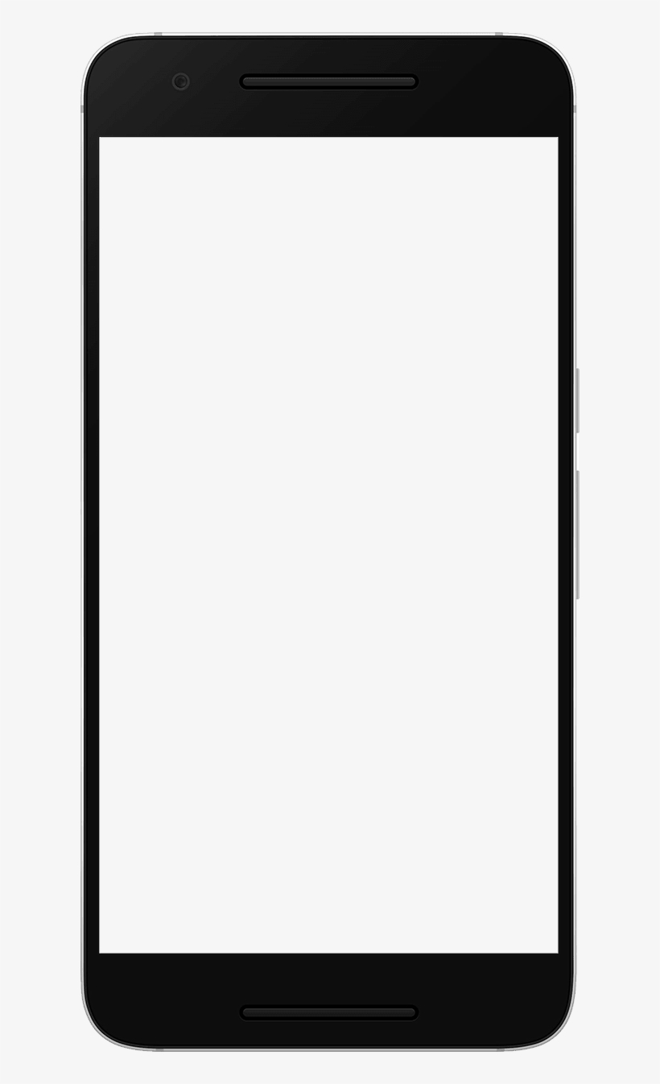
The FlatList Element
And our dream is to have a way to convert this array of objects into a list of React Native components that shows up on our device.
{ name: “Ben”}
{name: “Ted”}
Ben
Ted
The FlatList element will help us do this!
{name: “Chris”}
Chris
Matt
{name: “Matt”}
James
{name: “James”}

Slide 20
The FlatList Element
In order to do its job, a FlatList needs us to specify two props.
Remember, props is the hip way of referring to properties. They make elements parametrized/configurable/customizable!
Those two props are…
1.) Data!
This is the array that we were just talking about! The stuff that we want to go into the list!
2.) A renderItem function.
This is how you specify how you want the items in the list to look.
Ultimately it will return another piece of JSX.
It’s a step towards creating the fancy/beautiful looking lists from the start of lecture!

Slide 21
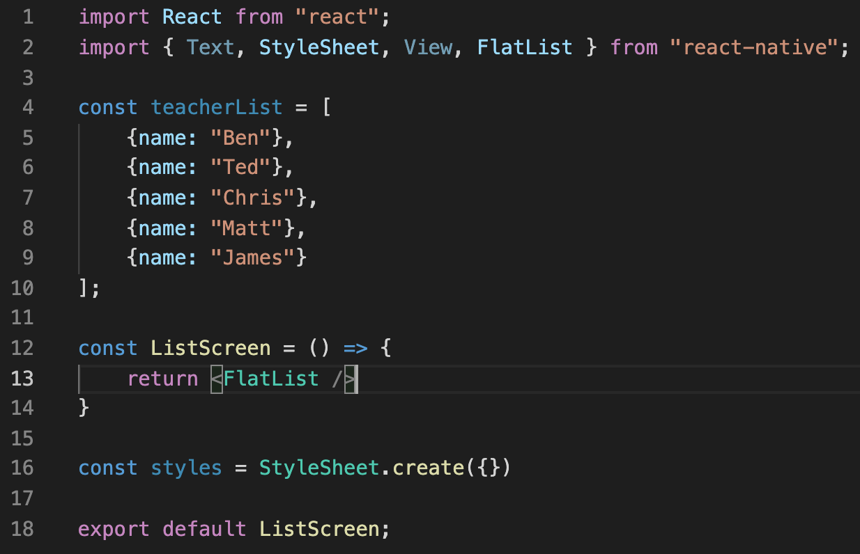
The FlatList Element
OK! Let’s start putting this stuff together!
Can you spot the things that we’ve added here?

Slide 22

The FlatList Element
We’re importing the FlatList element from “react-native” – easy!

Slide 23





The FlatList Element
We made an array of objects!
Easy once you’re familiar with it!
Might need to stare at it for a moment if you are new to JavaScript.
Everything between the [ ] are the contents of the array.
Each element of the array is separated by a comma.
Each element is an object, here each object just has one variable: the name.

Slide 24


The FlatList Element
And we sneakily changed our JSX to return a FlatList element.
Note how there isn’t a separate closing tag for FlastList
i.e., it isn’t like <FlatList>blah blah some stuff </FlatList>
And is instead <FlatList />
Although many elements will need opening and closing tags, some are self contained like this! They “open and close” at the same time!

Slide 25
The FlatList Element
So great! But we said we needed to specify two props for our FlatList, but currently we are giving it zero props!
Let’s address that right now!
Real quick, what were the props we needed again?

Slide 26
The FlatList Element
The props were data and renderItem!
So for those of you following along at home, take, oh, 15 seconds to guess/write: how might you “give” our teacherList to our FlatList as data using a prop?

Slide 27
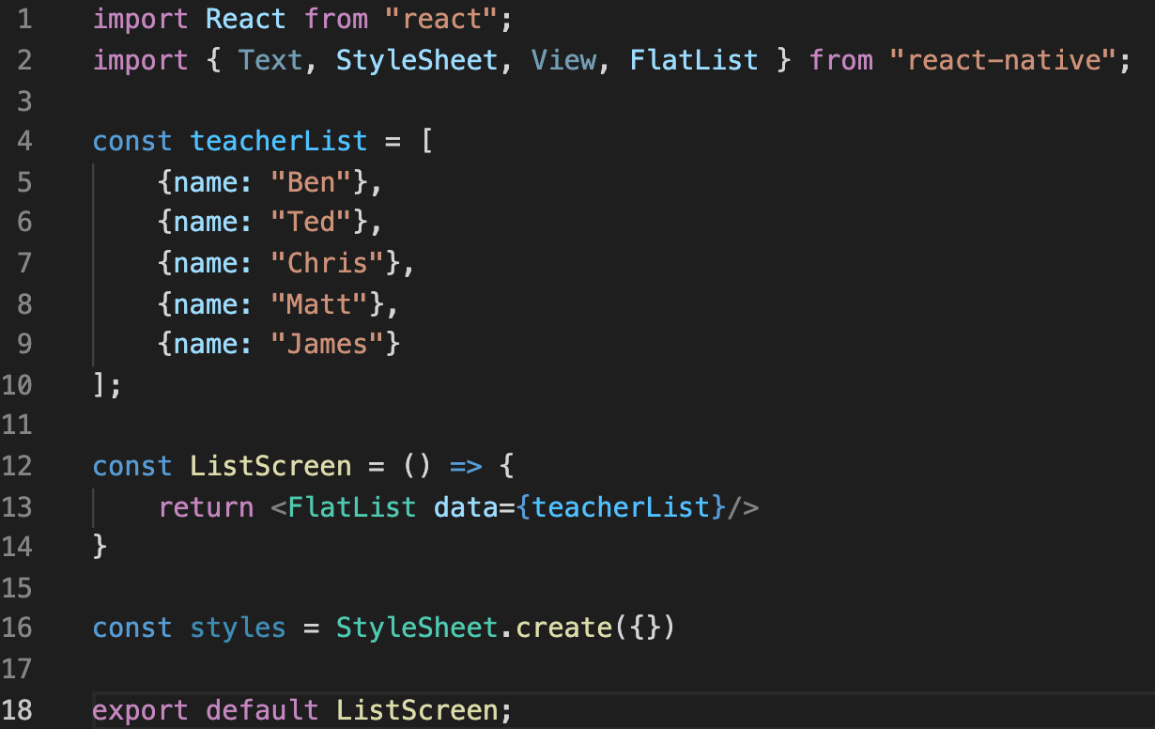

The FlatList Element
Probably something like this, yeah?
data={teacherList}
If we break that down…
data is the name of our prop here.
The = means we are setting that prop to some value.
In JSX, if we want to use a variable, we enclose it in { }
teacherList is the name of our array, defined on lines 4-9.

Slide 28
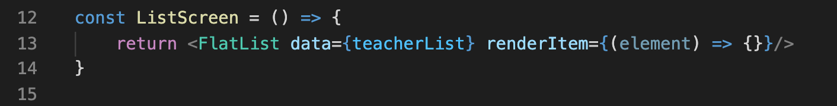


The FlatList Element
The second prop, renderItem is a little more complicated! You can see it (partially implemented) above.
The name of the prop is renderItem – not so bad so far!
And I mentioned earlier that the value of renderItem needs to be a function – a function that returns JSX that specifies how the elements in the list should get rendered.
Even though it’s a lot of parentheses and curly braces and other syntax, that’s all that this is right here, a function!
The (element) part is the parameter list of the function (more in just a second)
The => is just the syntax for defining an arrow function like this.
And the {} will be where the function body goes. Currently it is empty.

Slide 29
The FlatList Element
Before we implement the body, let’s make sure we understand that element parameter.
{ name: “Ben”}
{name: “Ted”}
Ben
We recall, the dream is something along the lines of this, right?
We have our nice array of data, and we want some way to render that data to the screen.
What might element refer to?
Ted
{name: “Chris”}
Chris
Matt
{name: “Matt”}
James
{name: “James”}

Slide 30
The FlatList Element
You might be tempted to guess that element refers to the element in the array that we are currently rendering.
E.g., starting at the top of the list, passing that element into the renderItem function, renderItem using it to produce some JSX, which then gets rendered onto our phone screen.
{ name: “Ben”}
Ben
{name: “Ted”}
{name: “Chris”}
renderItem({name: “Ben”})
{name: “Matt”}
{name: “James”}

Slide 31
The FlatList Element
And then doing the same thing with the next item on the list…
{ name: “Ben”}
Ben
{name: “Ted”}
Ted
{name: “Chris”}
renderItem({name: “Ted”})
{name: “Matt”}
{name: “James”}

Slide 32
The FlatList Element
And the next item… and so on…
And this is mostly what’s happening, but not exactly!
It totally is going through each element in our array one by one and invoking the renderItem function on each one…
The difference is that it isn’t the exact same object EXACTLY that is being passed in! It is instead a (similar!) object that also contains some additional metadata.
{ name: “Ben”}
Ben
{name: “Ted”}
Ted
Chris
{name: “Chris”}
renderItem({name: “Chris”})
{name: “Matt”}
{name: “James”}

Slide 33
The FlatList Element
When we pass in the first element in our array to the function, “element” has *more* than just the object in the array.
It has an item property – that property holds the original data.
It also has an index property – letting you know what index in the original array the data comes from.
{ name: “Ben”}
renderItem(element)
Ben
{name: “Ted”}
This is what element would look like at first:
{
item : { name : “Ben” },
index : 0
}
{name: “Chris”}
{name: “Matt”}
{name: “James”}

Slide 34
The FlatList Element
When we pass in the first element in our array to the function, “element” has *more* than just the object in the array.
It has an item property – that property holds the original data.
It also has an index property – letting you know what index in the original array the data comes from.
{ name: “Ben”}
renderItem(element)
Ben
{name: “Ted”}
Ted
This is what element would look like at first:
{
item : { name : “Ted” },
index : 1
}
{name: “Chris”}
{name: “Matt”}
{name: “James”}

Slide 35

The FlatList Element
So often, it’s the item property that we actually care about, since that’s the data from our array, and presumably what we want to render to our devices.
{ name: “Ben”}
renderItem(element)
Ben
{name: “Ted”}
Ted
This is what element would look like at first:
{
item : { name : “Ted” },
index : 1
}
{name: “Chris”}
{name: “Matt”}
{name: “James”}

Slide 36
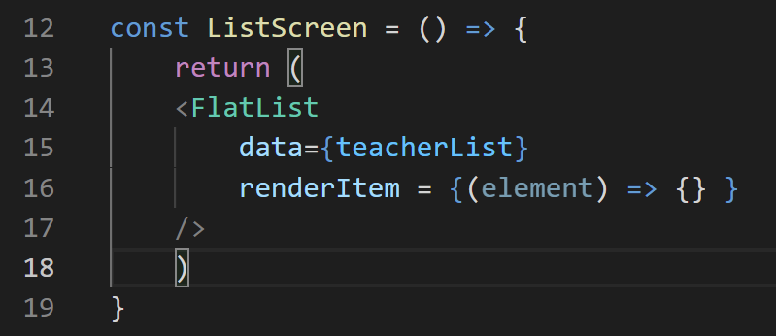
The FlatList Element
Because of this, we can use another Javascript trick, destructuring, to basically just pass in item directly.
(We’ll use it in just a second, but for future reference, here ya go: https://developer.mozilla.org/en-US/docs/Web/JavaScript/Reference/Operators/Destructuring_assignment)
Let’s look at our code split across multiple lines, to make it easier to read…
This is the same thing as we had before, yeah?

Slide 37
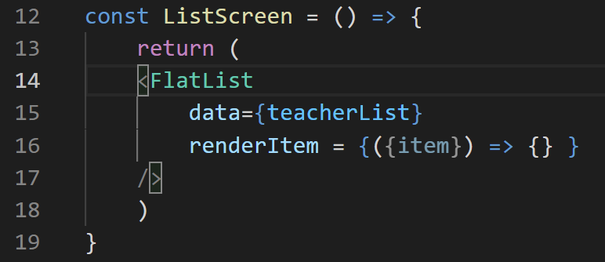


The FlatList Element
Now, instead of having element in our parameter list, we are going to change our parameter list to include {item} instead.
Like this:

Slide 38



The FlatList Element
We’ve got lots of nesting going on here, but it’s not so bad!
Everything inside the outer { } defines the function that will be given to the renderItem prop.
Then, the ( ) still represents the parameter list, i.e., what gets input into the function so that it does its job.
We know that it’s going to, one by one, be each element from our array.
Then the {item} destructures the passed in element, passing in only the value of its item property.

Slide 39

The FlatList Element
So, OK, great! We’ve dealt with the parameter list!
We still haven’t actually dealt with the function body yet! It’s still totally empty!
What goes inside of that?

Slide 40
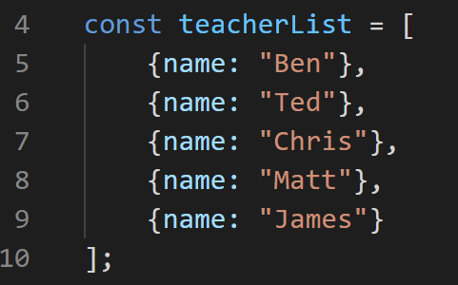
The FlatList Element
Remember: the whole goal of this renderItem function is to, well, specify how to render any given item!
We’ll do that by having this function return some JSX!
Quick 30 second challenge: what if we simply wanted to return JSX to render each person’s name? How would we do that?

Slide 41
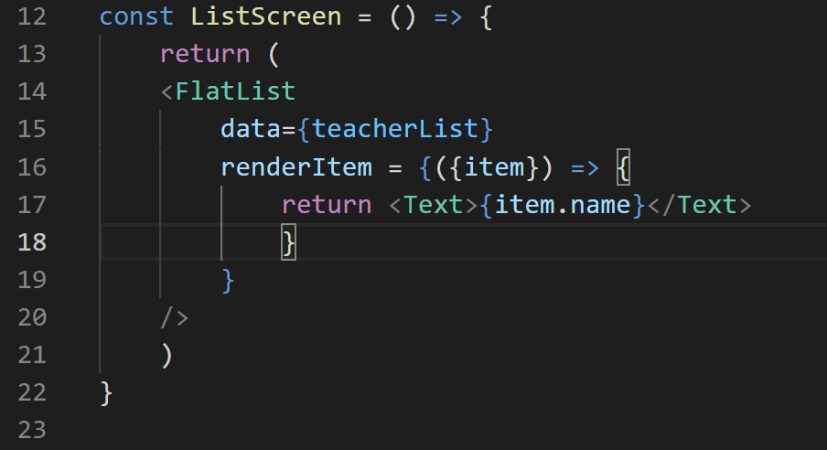
The FlatList Element
Maybe something like this, yeah? Our function body is on line 17
The opening and closing braces for it are on lines 16 and 18.
And by this point, we’ve seen all of this before!
return – we are defining a function that returns some JSX
<Text> … </Text> -- The opening and closing Text tags, that define that the JSX we are returning is specifically a Text element.
{item.name} – The way we specify variables. item is what we are passing in, representing an item in the teacherList array. We defined each of those items to have a name property.

Slide 42
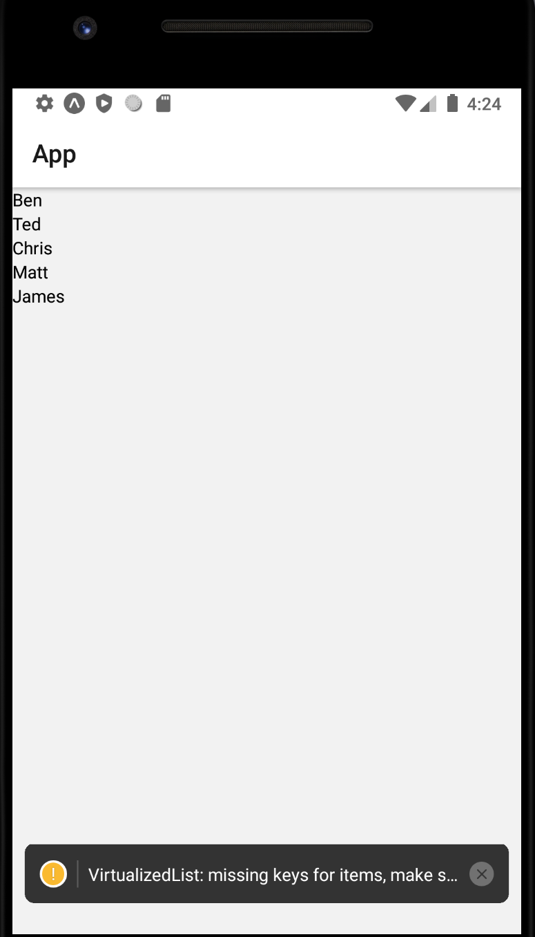
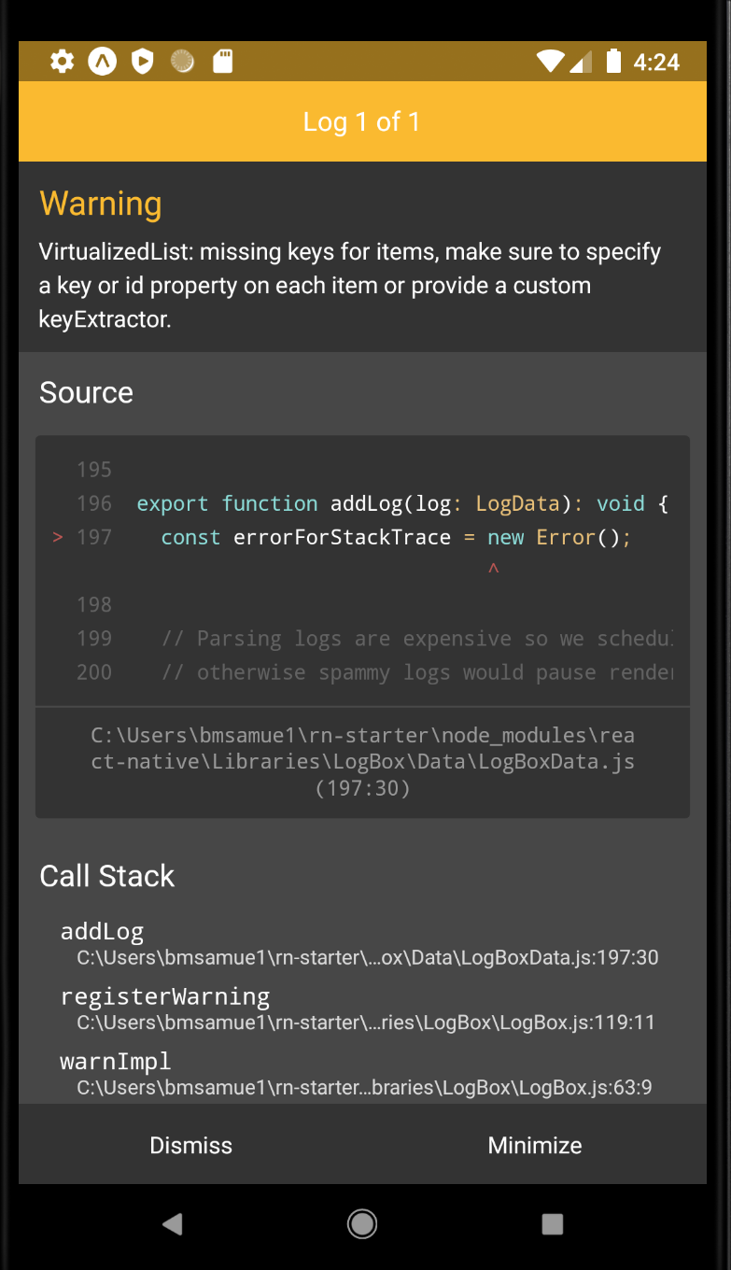
The FlatList Element
If you were to save and run this, you should, indeed, see a lovely little list!
But along with the list: a warning message!
Clicking on the warning message will complain about “missing keys for items”

Slide 43
The FlatList Element
So what is it complaining about?
What is a Key Property?

Slide 44
The FlatList Element
So what is it complaining about?
What is a Key Property?
And why is it a problem that’s worth fixing?

Slide 45
Today’s Agenda
Introduction to Lists!
The FlatList Element
Key Properties
Some Additional FlatList Notes
A Final Challenge

Slide 46
Key Properties
We’ll discuss the solution in just a moment, but first, let’s dig behind the scenes just a smidge to understand *why* we need to solve it.
It ultimately boils down to a performance issue.

Slide 47

Key Properties
So, here’s the situation we’re in now, without a Key property.
We have our array of data on the left, and the output we’d expect on the phone on the right.
{ name: “Ben”}
Ben
{name: “Ted”}
Ted
Chris
{name: “Chris”}
Matt
James
{name: “Matt”}
{name: “James”}

Slide 48
Key Properties
What do you think would happen to the output if we got rid of one of our records?
If you said “it would go away” you’d be right!
But the tricky part is – how would it go away…?
{ name: “Ben”}
Ben
Ben
{name: “Ted”}
Ted
Ted
Chris
Chris
{name: “Chris”}
Matt
James
James
{name: “James”}

Slide 49




Key Properties
Without the key property in place, it wouldn’t *just* delete that one record…
It would actually delete the entire list first!
And then rebuild it, this time without that record!
{ name: “Ben”}
Ben
Ben
{name: “Ted”}
Ted
Ted
Chris
Chris
{name: “Chris”}
Matt
James
James
{name: “James”}

Slide 50




Key Properties
It takes time to delete and re-render a list!
And if your data is changing a lot and/or if your list(s) are long, this can really slow your app down!
{ name: “Ben”}
Ben
Ben
{name: “Ted”}
Ted
Ted
Chris
Chris
{name: “Chris”}
Matt
James
James
{name: “James”}

Slide 51
Key Properties
It would be better if it just kinda, worked the way you’d expect it to, right?
Deleting that one record, and moving everything after it up, but not fiddling with anything that doesn’t need to change.
Well, of course, this is where keys come into play.
{ name: “Ben”}
Ben
Ben
{name: “Ted”}
Ted
Ted
Chris
Chris
{name: “Chris”}
Matt
James
James
{name: “James”}

Slide 52
Key Properties
Let’s alter our data, so that each element in our data array has a key.
key : ‘A’
{ name: “Ben”}
{name: “Ted”}
Ben
key : ‘A’
key : ‘B’
Ted
key : ‘B’
key : ‘C’
{name: “Chris”}
Chris
key : ‘C’
key : ‘D’
{name: “Matt”}
Matt
key : ‘D’
James
key : ‘E’
(FYI, we’re not actually displaying the key on the phone, I’m just adding them here for illustrative purposes)
key : ‘E’
{name: “James”}

Slide 53
Key Properties
It just so happens that this was the missing piece!
Now, if we delete “Matt” (which has a Key of D), react native will be smart enough to only delete the text that matches the key of the removed data (again, here D).
key : ‘A’
{ name: “Ben”}
{name: “Ted”}
Ben
key : ‘A’
key : ‘B’
Ted
key : ‘B’
key : ‘C’
{name: “Chris”}
Chris
key : ‘C’
James
key : ‘E’
key : ‘E’
{name: “James”}

Slide 54
Key Properties
Essentially, by providing keys, you give React Native the tools to map the data to the actual rendered elements on the screen.
And with that map, it means you can alter/change/delete the data and React Native will know specifically which element(s) to update, without rebuilding the whole thing from scratch!
key : ‘A’
{ name: “Ben”}
{name: “Ted”}
Ben
key : ‘A’
key : ‘B’
Ted
key : ‘B’
key : ‘C’
{name: “Chris”}
Chris
key : ‘C’
James
key : ‘E’
key : ‘E’
{name: “James”}

Slide 55
Key Properties
Ok. By this point hopefully you’re convinced that this is a nice performance optimization to do.
The question now is: how do we do it?
The answer: we’ll go over two different ways!
Really up to you which one to use!
But it’s always helpful to know both!

Slide 56

Key Properties – Solution 1
The first solution is very straight forward!
You simply give each object in your data array an additional property, called key!
{ name: “Ben”}
{ name: “Ben”, key: “1”}
{name: “Ted”}
{name: “Ted”, key: “2”}
{name: “Chris”}
{name: “Chris”, key: “3”}
{name: “Matt”}
{name: “Matt”, key: “4”}
{name: “James”}
{name: “James”, key: “5”}

Slide 57
Key Properties – Solution 1
If you do it this way, there’s some rules about the keys:
The keys all have to be strings.
They need to be unique across each element in our array.
They need to not change between renders.
{ name: “Ben”, key: “1”}
{name: “Ted”, key: “2”}
{name: “Chris”, key: “3”}
{name: “Matt”, key: “4”}
{name: “James”, key: “5”}

Slide 58
Key Properties – Solution 1
If you do it this way, there’s some rules about the keys:
The keys all have to be strings.
They need to be unique across each element in our array.
They need to not change between renders.
{ name: “Ben”, key: “1”}
Keys being String is simple enough!
And just as in other languages, in JavaScript, if you enclose content using “ “ it makes it a string!
All of these keys are strings, even though the content of each string is a number.
{name: “Ted”, key: “2”}
{name: “Chris”, key: “3”}
{name: “Matt”, key: “4”}
{name: “James”, key: “5”}

Slide 59
Key Properties – Solution 1
If you do it this way, there’s some rules about the keys:
The keys all have to be strings.
They need to be unique across each element in our array.
They need to not change between renders.
{ name: “Ben”, key: “1”}
Also pretty simple!
Note how each key is different here, that’s good!
IF, say, both Matt and James had the same key of “4”, then React Native would get confused as to which element it was mapping to.
{name: “Ted”, key: “2”}
{name: “Chris”, key: “3”}
{name: “Matt”, key: “4”}
{name: “James”, key: “5”}

Slide 60
Key Properties – Solution 1
If you do it this way, there’s some rules about the keys:
The keys all have to be strings.
They need to be unique across each element in our array.
They need to not change between renders.
{ name: “Ben”, key: “1”}
This is basically just getting at the idea that they should be consistent.
{name: “Ted”, key: “2”}
{name: “Chris”, key: “3”}
{name: “Matt”, key: “4”}
{name: “James”, key: “5”}

Slide 61
Key Properties – Solution 2
OK! Now let’s move on to the alternative solution!
For this solution, note that we’re going back to the original data array. We’ve removed the key property from the objects inside of it.
{ name: “Ben”}
{name: “Ted”}
{name: “Chris”}
{name: “Matt”}
{name: “James”}

Slide 62
Key Properties – Solution 2
The second solution involves adding another prop to our FlatList element. This prop is called keyExtractor.
Similar to the renderItem prop, keyExtractor needs to be given a function.
Also similar to renderItem, this function will be called on each element of our data array.
keyExtractor gives us a way to dynamically specify a key based on the existing properties of our data!

Slide 63
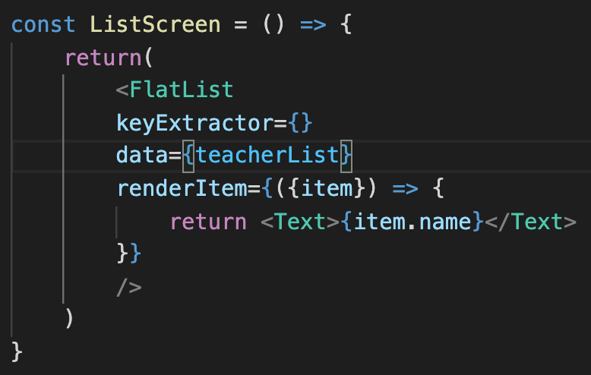

Key Properties – Solution 2
So it will start looking something like this:
We’ve added the keyExtractor prop, but it is currently empty.

Slide 64
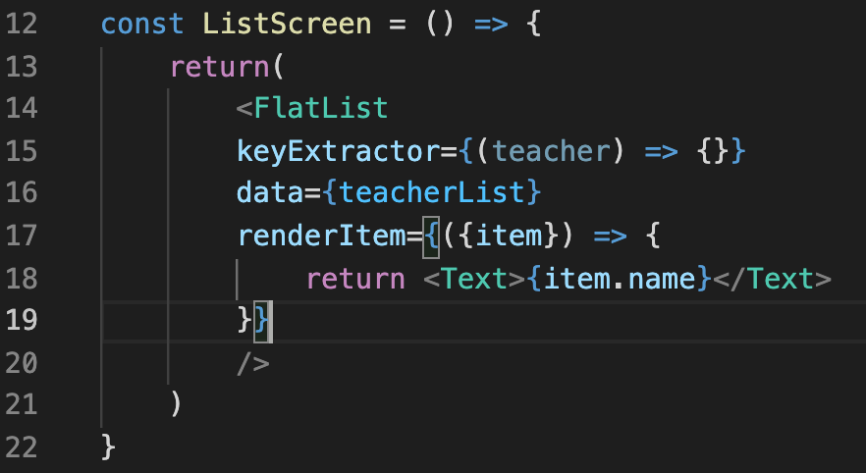

Key Properties – Solution 2
We know that we want to give the prop a function, and we’ve seen a few times now what that looks like in JavaScript/JSX land:
We need to specify the parameter list inside of ( ) .
And we specify the function body inside of { }.

Slide 65

Key Properties – Solution 2
Here, our parameter list is
(teacher)
We could have called the parameter anything---nothing sacred about the word teacher here---but because we know we’re going to be passing in each element from our teacher array, this seems like a good, descriptive name!

Slide 66
Key Properties – Solution 2
What do you think might go into the body here?
Take a second to think about it!
We know we want our function return something that will serve as the key for the passed in object.
And we know that we want our keys to be:
Strings
Unique
Consistent

Slide 67
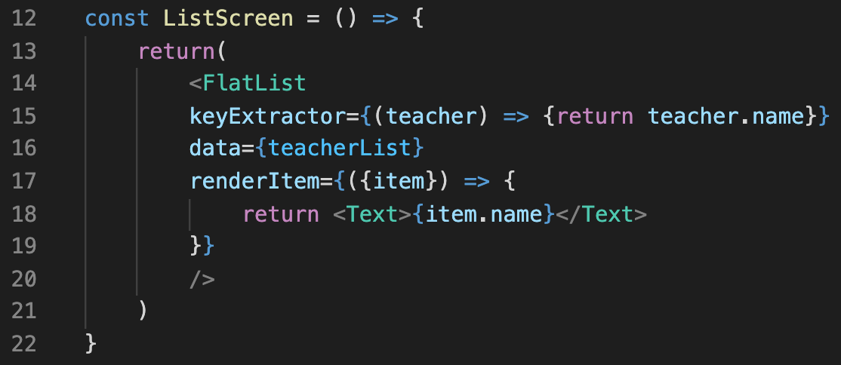

Key Properties – Solution 2
Maybe something like this!
We recall that each of our objects has a name property already…
And that name is a string…
That is unique for each teacher…
And that we’re not planning on changing, i.e., will be consistent!

Slide 68

Key Properties – Solution 2
This keyExtractor solution is generally what we’ll be using.
Typically involves less typing!
Keeps our data “cleaner”
Now, our data only has stuff pertaining to teachers!
We didn’t have to sully our data with additional information that is only connected to how the data is displayed.

Slide 69
Today’s Agenda
Introduction to Lists!
The FlatList Element
Key Properties
Some Additional FlatList Notes
A Final Challenge

Slide 70
Additional FlatList Notes
Just some last minute things to check out!

Slide 71
Additional FlatList Notes
The first is confirming that, as your list gets very long, you can see that your list will be scrollable automatically!
On iOS devices, your list might be scrollable even without it being very long!
Regardless, we can test this by *forcing* our list to become huge!
We’ll do this with a new styling trick!

Slide 72
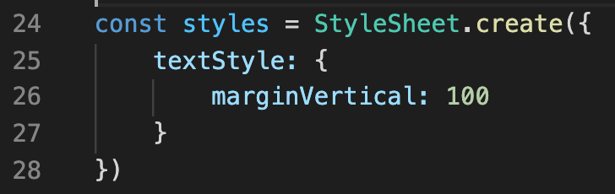
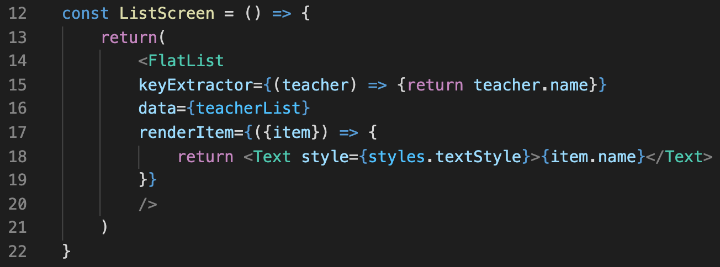


Additional FlatList Notes
Here’s our updated StyleSheet!
marginVertical will add vertical space above and below elements that are styled with it.
And here, we’re just specifying that we want this style to apply to the Text elements in our list!
You should find that your list is now very long, and scrollable!

Slide 73
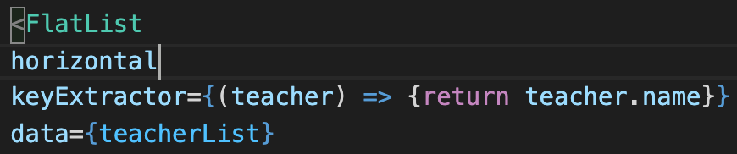
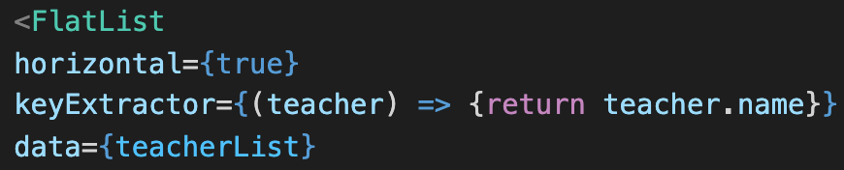


Additional FlatList Notes
There’s a couple of other quick thoughts I want to leave you with, too!
One is the horizontal prop!
If you specify this in your FlatList element, your items will arrange horizontally, instead of vertically!
Two ways to specify it!

Slide 74
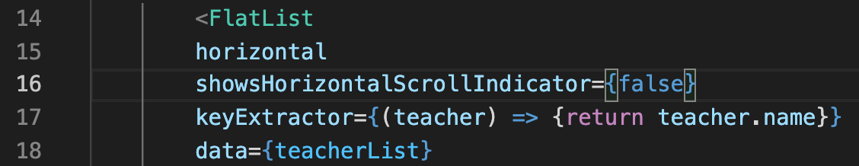

Additional FlatList Notes
The second is a prop with a long name:
showsHorizontalScrollIndicator
As you may know – when there’s a lot of horizontal content, your phone will generate a horizontal scroll bar for you as you scroll through it!
But sometimes you may not like that!
This is a way that you can turn it off!

Slide 75

Additional FlatList Notes
This might seem silly right now, but next time you open an app of your own that has horizontal scrolling, check to see if it uses a scrollbar or not!
They can be surprisingly distracting!

Slide 76
Today’s Agenda
Introduction to Lists!
The FlatList Element
Key Properties
Some Additional FlatList Notes
A Final Challenge

Slide 77
A Final Challenge
With whatever time we have left / something to challenge yourself with on your own!
If you haven’t been following along at home, the first part of the challenge is to simply make a FlatList (feel free to have it be the teacher one!)
But then, in addition to the list just printing out names, do the following:
1.) Add additional data to the list
(could be anything! What classes they teach, how old you think they are, etc.)
2.) Have your list print out both the names and that additional data.

